Slide 1
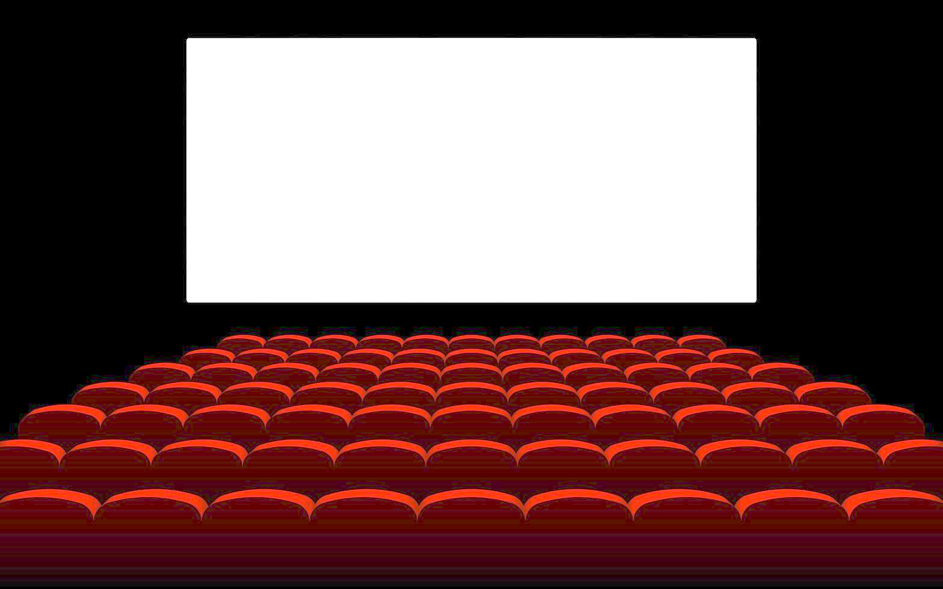
Movie search
IR Final Project
Stefano Taillefert

Slide 2


Main idea
Step 1: Crawl sites like IMDb, RottenTomatoes, allmovie.com
Step 2: Get movies metadata (title, description, rating, …)
Step 3: Index all the data
Step 4:
Step 5: Profit
?

Slide 3

Focus
Simplicity of installation and usage
Versatility and power
Easily extendable

Slide 4
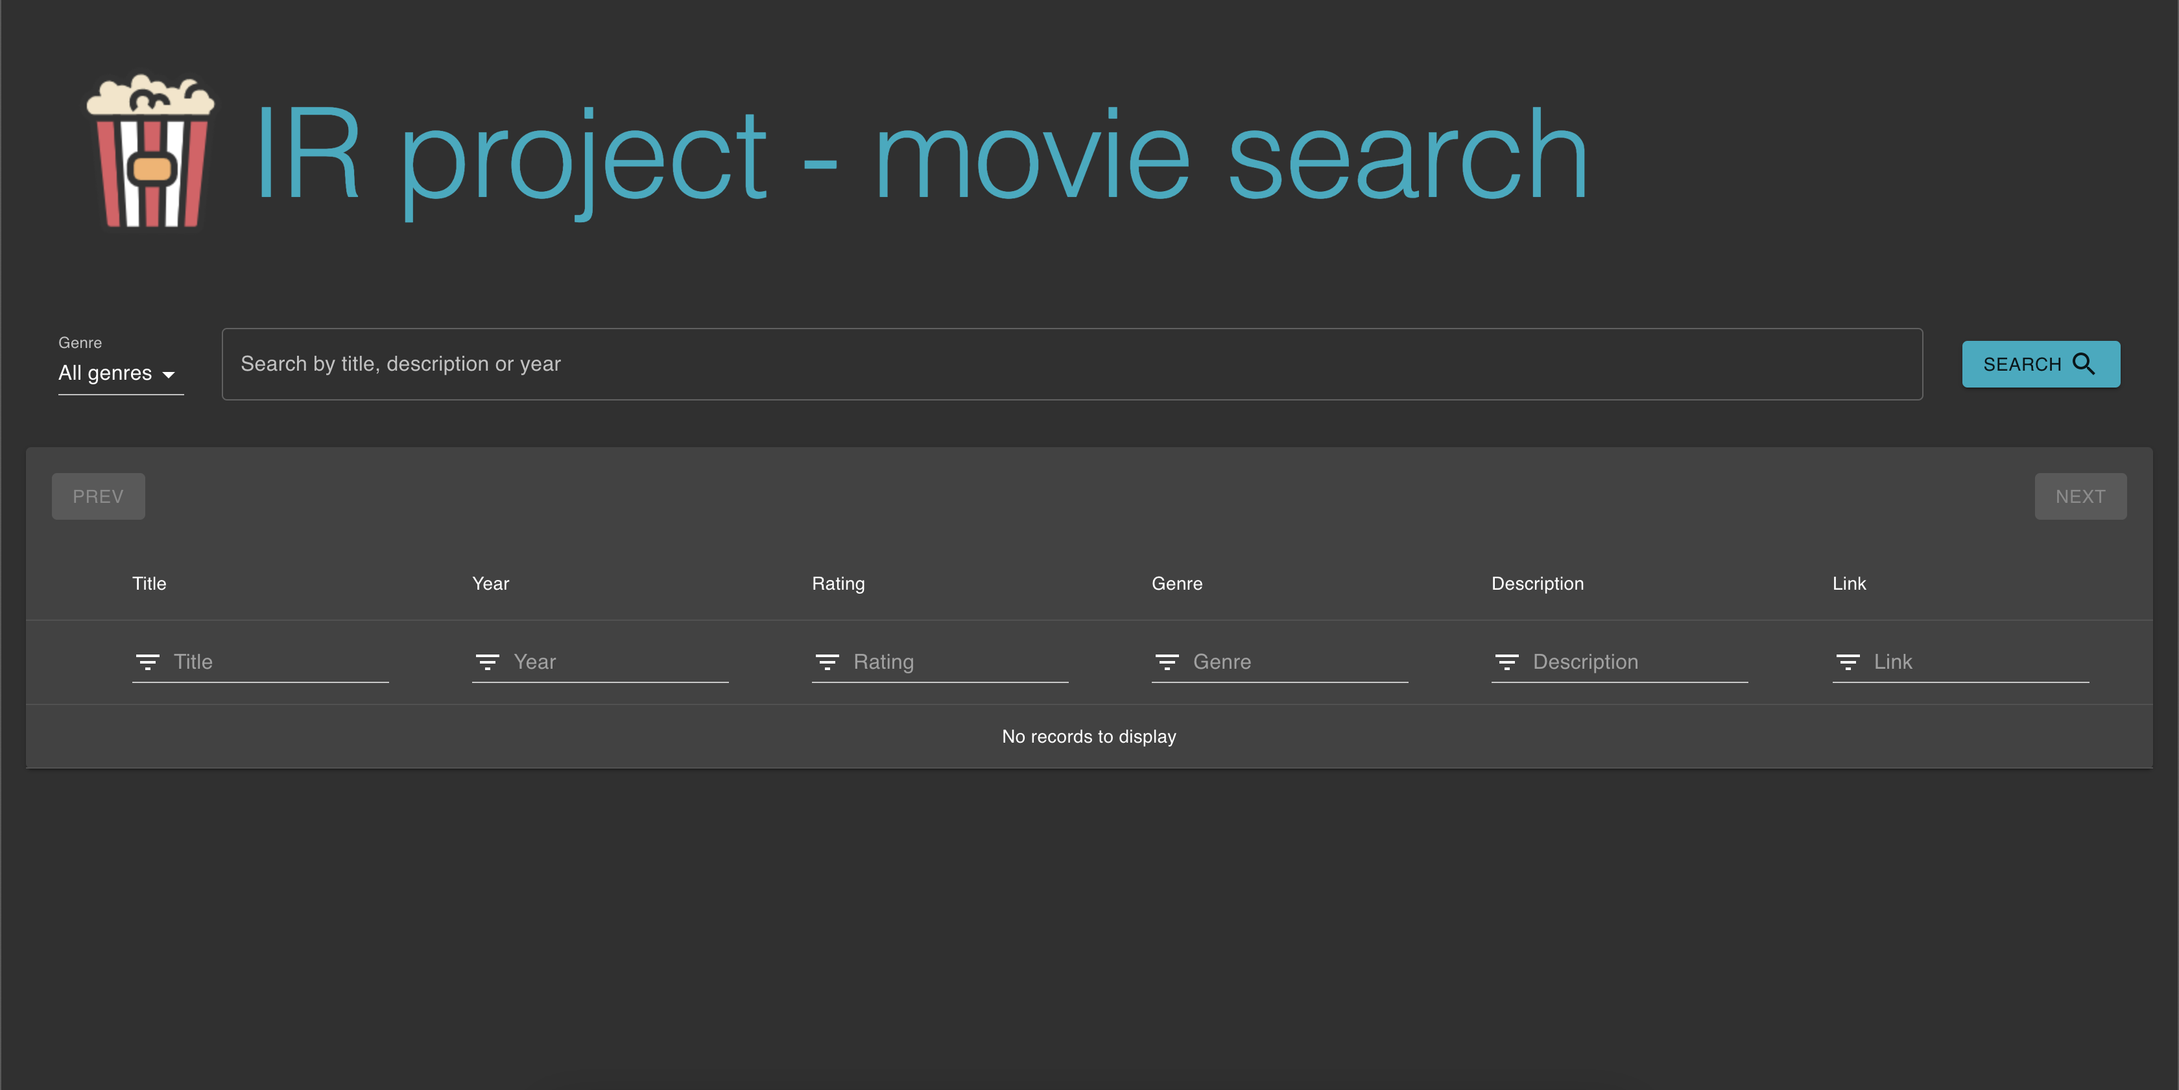
Nice and clean UI

Slide 5





Tech stack

Slide 6
Tech stack (scaled)

Slide 7

Problems encountered
Had to adapt some React components to custom behaviour
Docker networking adds complexity
Enabling clustering broke my Solr

Slide 8

Questions

Slide 9

Demo time!

